Slide 1

“OIL SPILL DETECTION”
Project Presentation
MITU22BTCS0228:- Kunal Borse
MITU22BTCS0:- Rugved Shete
MITU22BTCS0260:- Dheeraj Nair
Guided by:- Prof. Vilas Khedekar
Department of Computer Science & Engineering, MITSoC, Loni Kalbhor

Slide 2
Outline
Introduction
Problem Statement
Objectives
Concepts & Methods
Literature Review
Identification of gaps & scope of work
Implementation
Reference
Q&A
Department of Computer Science & Engineering, MITSoE, Loni Kalbhor

Slide 3
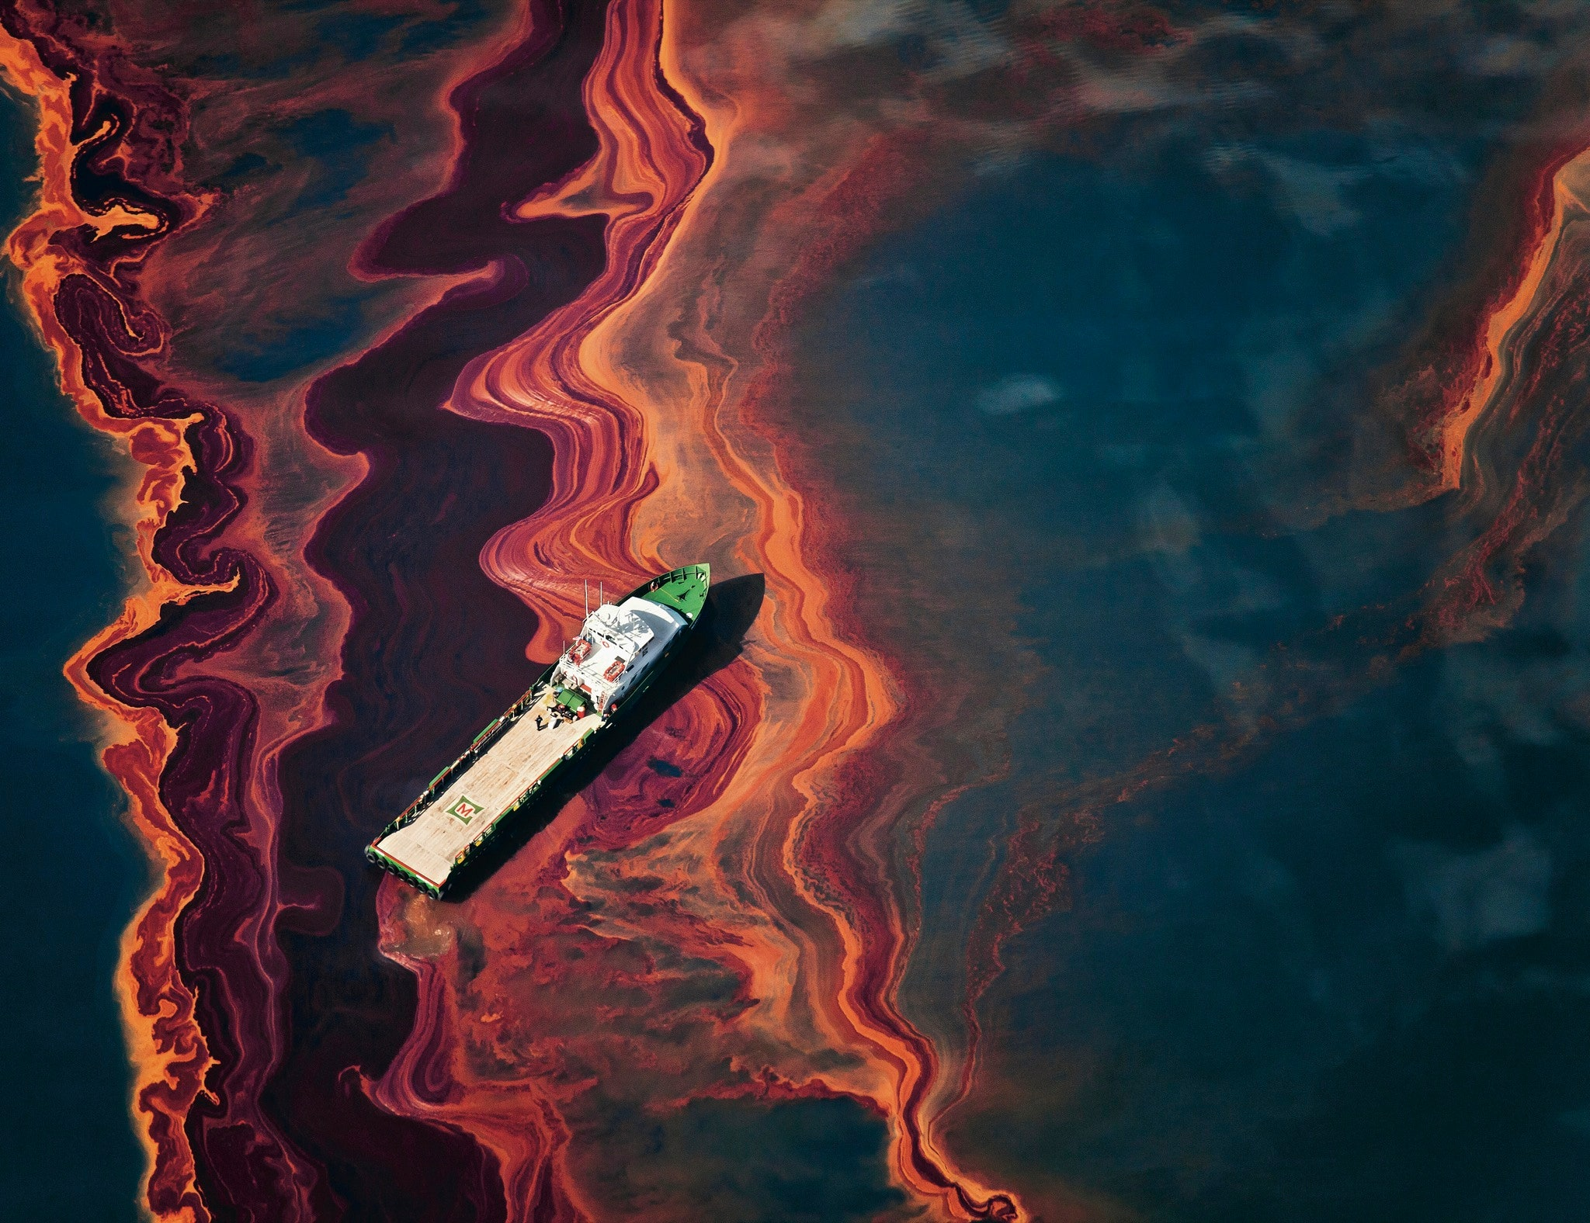
Introduction
This project focuses on creating a system that uses satellite images and machine learning to detect oil spills in the ocean. Oil spills can have serious negative effects on marine life and coastal communities, and traditional methods of spotting them are often slow and require a lot of manual effort. Our approach aims to streamline the process by automating detection, which could help environmental agencies respond more quickly and effectively to these accidents. In this project, we explain how we harness remote sensing data, develop and train our machine learning model, and test the system’s accuracy in distinguishing oil spills from other similar features on the water.
Department of Computer Science & Engineering, MITSoE, Loni Kalbhor

Slide 4
Problem Statement
Oil spills pose a significant environmental threat to marine ecosystems, affecting aquatic life and coastal economies. Early detection and timely response are crucial to mitigating their impact. This project aims to develop a machine learning model that classifies satellite images of water bodies as an oil spill or no spill.
Environmental Threat: Oil spills pose a serious threat to marine ecosystems, affecting wildlife, water quality, and coastal communities, necessitating timely detection and mitigation.
Delayed Detection: Traditional oil spill detection methods are often slow, labor-intensive, and dependent on manual observation or limited satellite passes, leading to delayed response times.
Limited Coverage: Current monitoring systems may lack real-time capability or have limited spatial coverage, making it difficult to detect smaller or remote spills effectively.
Integration with Response Systems: There is a lack of integration between detection systems and emergency response frameworks, delaying containment and cleanup operations once a spill is identified.
Objectives
The objective of this project is to develop an automated and accurate oil spill detection system using remote sensing data and machine learning techniques. It aims to enhance detection accuracy, reduce false positives, and support timely response efforts to minimize environmental impact and protect marine and coastal ecosystems.
Department of Computer Science & Engineering, MITSoE, Loni Kalbhor

Slide 5
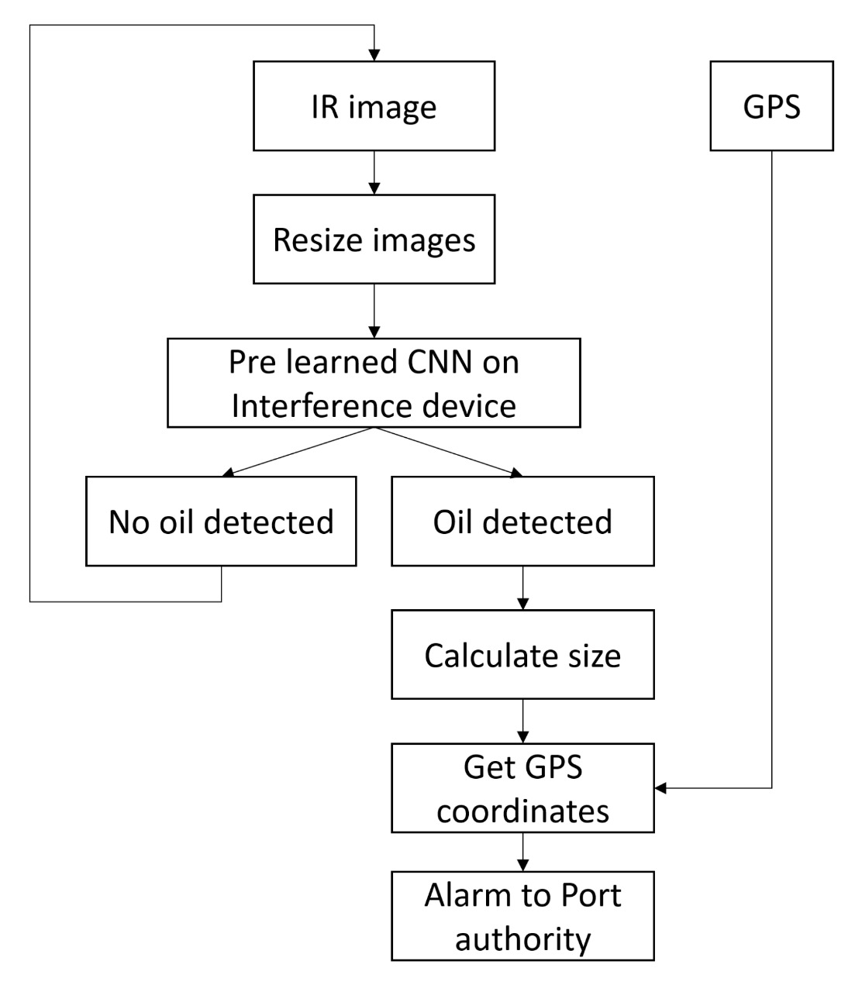
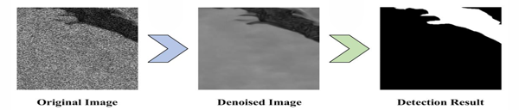
Concepts and Methods
1) Satellite Imagery: Captures high resolution images of the ocean surface to detect and monitor oil spill patterns and spread.
2) Remote Sensing: Utilizes various sensors on satellites to analyze the oil's spectral signature and differentiate it from water.
3) Data Analytics: Applies algorithms and machine learning to interpret oil spill data and satellite images, improving spill detection accuracy.
4) Aerial Surveillance (Drones and Aircraft):
Captures high-resolution images or videos to visually detect and monitor oil spills, especially in remote areas.
Department of Computer Science & Engineering, MITSoE, Loni Kalbhor

Slide 6
Literature Survey
Sr. no | Literature Title | Author | Findings
1. | The Application of Satellite Image Analysis in Oil Spill Detection | Paweł Tysiąc, Tatiana Strelets, Weronika Tuszyńska | This study explores the use of satellite imagery for detecting oil spills, emphasizing the effectiveness of synthetic aperture radar (SAR) data in identifying oil slicks under various environmental conditions.
2. | Hyperspectral Remote Sensing Benchmark Database for Oil Spill Detection with an Isolation Forest-Guided Unsupervised Detector | Puhong Duan, Xudong Kang, Pedram Ghamisi | The paper introduces an unsupervised method for oil spill detection using hyperspectral imagery, by employing an Isolation Forest algorithm. The approach effectively distinguishes oil spills from seawater without the need for extensive labeled datasets.
3. | Variable-Complexity Machine Learning Models for Large-Scale Oil Spill Detection: The Case of Persian Gulf | Mohammad Danesh-Yazdi. Sahand Najafizadegan | Developed and compared machine learning models—Support Vector Machine (SVM), Random Forest (RF), and Convolutional Neural Network (CNN), Found that CNN outperformed RF and SVM, achieving a testing accuracy of 95.8%, indicating its robustness for large-scale oil spill detection.
Department of Computer Science & Engineering, MITSoE, Loni Kalbhor

Slide 7
Identification of gaps & scope of work
Identification of Gaps
Limited Dataset Availability: Lack of large, labeled datasets for training and evaluating machine learning models specific to oil spills.
Detection Accuracy: Existing models may struggle with distinguishing oil spills from similar-looking features (e.g., algal blooms, ship waves).
Resolution Constraints: Many satellite images have medium to low resolution, reducing the ability to detect small-scale spills.
Environmental Variability: Changing sea conditions (waves, wind, lighting) affect the reliability of detection algorithms.
Scope of Work
Data Collection: Gather and preprocess satellite (SAR/optical) or drone-based images of oil spills and clean sea surfaces.
Model Development: Design and train a machine learning or deep learning model capable of accurately identifying oil spills.
Evaluation: Test model accuracy using performance metrics like precision, recall, F1-score, and confusion matrix.
Comparative Analysis: Compare different algorithms (e.g., SVM, CNN, Random Forest) to identify the most suitable method.
Scalability: Investigate the model’s ability to be deployed at scale for large geographic areas using satellite data.
Department of Computer Science & Engineering, MITSoE, Loni Kalbhor

Slide 8
Implementation
Department of Computer Science & Engineering, MITSoE, Loni Kalbhor

Slide 9
Results
1) Economic Benefits: Cuts costs, boosts growth, and creates jobs.
2) Environmental Benefits: Reduces impact, promotes sustainability, and saves resources.
3) Technological: Improves efficiency, performance, innovation and scalability.
4) Robust Against Look-Alikes: Successfully distinguished between oil spills and similar features like algae, ship wakes, and low-wind slicks in most test cases.
Department of Computer Science & Engineering, MITSoE, Loni Kalbhor

Slide 10
Conclusion and Future Work
To wrap it up, this project showed that using satellite images and machine learning can be a smart and reliable way to detect oil spills in the ocean. The system we built was pretty accurate and could tell the difference between actual oil spills and other things that look similar, like algae or ship trails. It also cuts down on the time and effort needed to spot spills manually. Overall, this kind of technology can really help us keep a closer eye on our oceans and respond more quickly to environmental accidents.
Department of Computer Science & Engineering, MITSoE, Loni Kalbhor

Slide 11
References
[1) Ngoc An Bui, Youngon Oh, and Impyeong Lee. "Oil spill detection and classification through deep learning and tailored data augmentation." International Journal of Applied Earth Observation and Geoinformation.
2) Xiaorui Dong, Jiansheng Li, Bing Li, Yueqin Jin, and Shufeng Miao. "Marine oil spill detection from low-quality SAR remote sensing images." Journal of Marine Science and Engineering.
3) Thomas De Kerf, Jona Gladines, Seppe Sels, and Steve Vanlanduit. "Oil Spill Detection Using Machine Learning and Infrared Imaging." Remote Sensing.
4) Najafizadegan,S.,&Danesh-Yazdi,M.(2023) Variable-complexity machine learning models for large-scale oil spill detection: The case of Persian Gulf.Marine Pollution Bulletin, 194, 115259.
5) Satellite Datasets (https://dataspace.copernicus.eu/).
6) SNAP tool for processing SAR datasets (https://step.esa.int/main).
Department of Computer Science & Engineering, MITSoE, Loni Kalbhor

Slide 12
Thank You
Department of Computer Science & Engineering, MITSoE, Loni Kalbhor

